Slide 1
RGF solver document
Lin Yen-Ju
2019/09/29

Slide 2
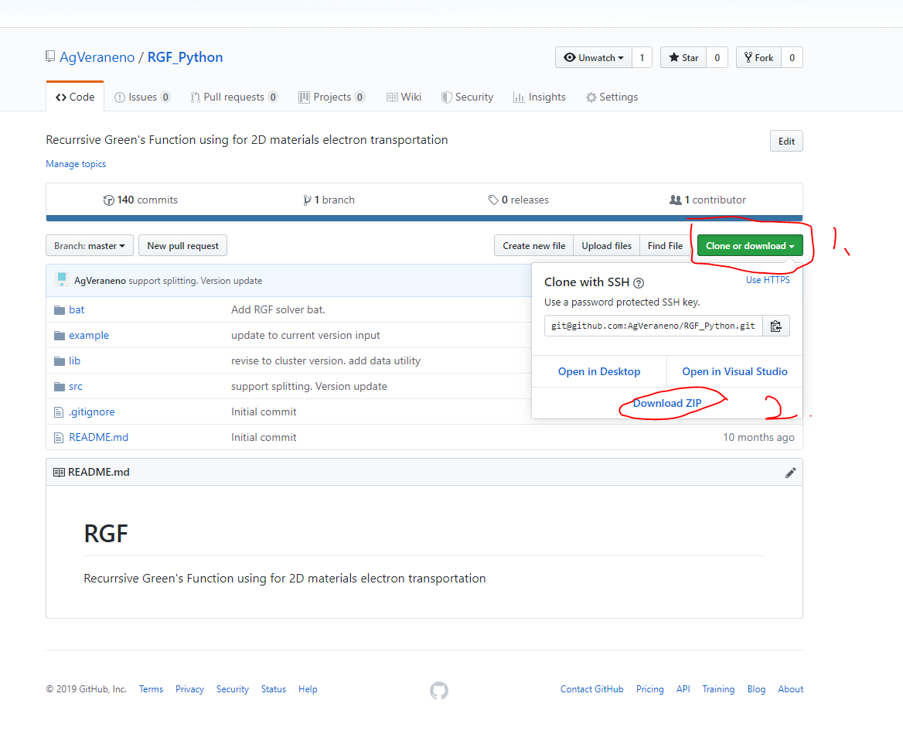
How to install
Requirement:
Python 3: (https://www.python.org/downloads/windows/)
numpy. With mkl version is preferred for Intel CPU. (https://www.lfd.uci.edu/~gohlke/pythonlibs/#numpy)
matplotlib
Github:
git. Use for program version control. Skip if get from zip(https://git-scm.com/download/win)
Repository: (https://github.com/AgVeraneno/RGF_Python)

Slide 3
How to run
Run src/RGF_solver.py directly. (Not recommended)
Run example/RGF_run.bat (windows OS) or execute in command line.
Useful options:
-i: assign input file to the program. E.g. –i C:\user\test.csv → assign a setting file in C:\user\test.csv
-turbo: assign # of CPU cores for parallel boost. E.g. –turbo 8 → assign 8 cores for boost. Note that numpy will auto use ~4 cores for large matrix operation. For 8 cores computer, 2 cores are recommended.

Slide 4
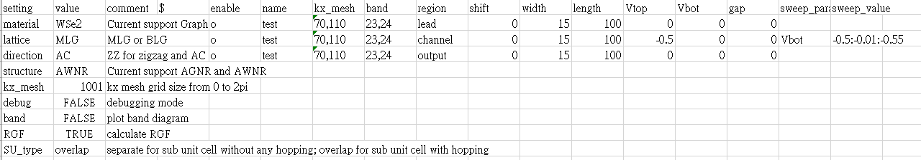
Setup file
Setting: program entrance to the setting value. (DO NOT REVISE)
Value: user inputs.
Material: material for the simulation. Currently support Graphene and WSe2.
Lattice: stacking layer type. MLG or BLG.
Direction: lattice direction. ZZ (zigzag) or AC (armchair)
Structure: simulation structure build in unit_cell.py. Currently support AGNR and AWNR.
Kx_mesh: mesh grid from 0 to 2π.
Debug: open debug mode. This will output Hamiltonian.
Band: calculate band diagram in each region.
RGF: calculate RGF.
SU_type: first sub unit cell type.
separate
overlap

Slide 5
Setup file
Enable: enable the definition in this run.
Name: job name
Kx_mesh (kx start, kx stop): kx points in RGF calculation.
Band (value or/and start:step:stop): target bands in RGF calculation.
E.g. 25,26,27 for calculating band 25, 26 and 27.
E.g. 25,26:2:30 for calculating band 25,26,28 and 30.
Region: region definition in this job.
Shift: add empty sub unit cell under real simulation region.
Shift, width, length: sub unit cell definition. See figure →
Vtop, Vbot: bias across unit cell. See figure →
Gap: gap energy of the structure. No use in TMDc system.
length
Vtop
width
Shift = 1
Vbot

Slide 6
Setup file
Sweep parameter:
Available items: shift, width, length, Vtop, Vbot, gap.
For structure sweep, please proceed with caution because this may raise matrix mismatch error.
Values:
Same input rule as “band”.

Slide 7
How to add material
Add new material’s hopping energy and other necessary parameters in lib_material.py.
Build Hamiltonian in unit_cell.py. Necessary output are 1) self.SU_size 2) self.H 3) self.Pf 4) self.Pb.
Self.SU_size: hopping matrix size. E.g. for graphene the value is 1. For WSe2 with 6 valid orbit, the value is 6.
Self.H: m unit cell Hamiltonian
Self.Pf: hopping relation between m and m+1 unit cell
Self.Pb: hopping relation between m and m-1 unit cell
Add entrance in RGF_solver.py line124~130. The entrance name will be used in setup file.

